Slide 1
Basketball Tracking with Deep Learning
By Trae Primm

Slide 2
Data Collection
My final dataset was a collection of images from a two hour recorded video of one of the basketball courts at The Fit. It consisted of 900 images.
The original dataset had to be scrapped due to the resolution being to low.

Slide 3
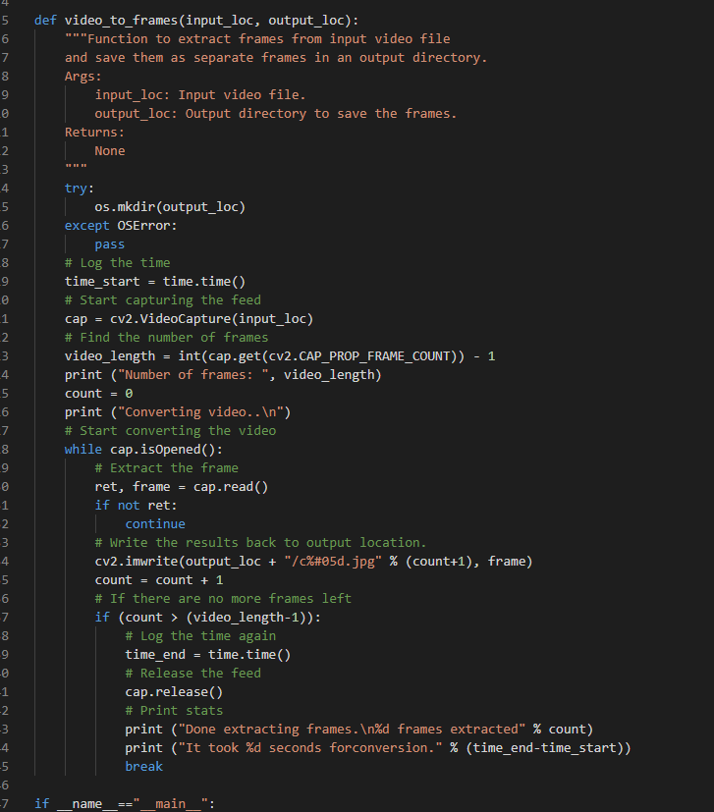
Vids_to_frames.py
This is the main function for the script that takes an input video and outputs frames to a directory.

Slide 4
Boxes
Yolo uses a bounding box method for classification. It needs the image and it also needs a txt file consisting of the box description.
The format should be: <object-class> <x> <y> <width> <height>
Thanks to tzutalin he uploaded a tool called labelimg to make the correct files for us.

Slide 5
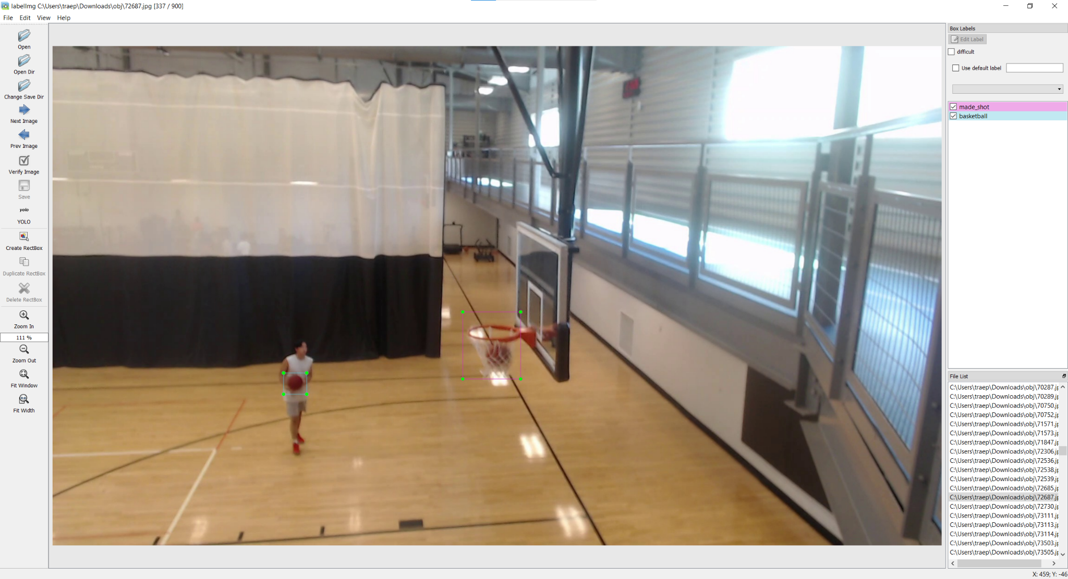

Slide 6
Training Montage
I had difficulties getting the model to run on a windows machine so I set up a google colab which is linux based to handle the model. Any time a code segment starts with a ! or % means it is a console command.
After setting up the correct configs and data structure I run this command:
!./darknet detector <function> <datafile> <.cfg> <weights> -dont_show -map
For me it looks like:
!./darknet detector train data/obj.data cfg/yolov4-basketball.cfg yolov4.conv.137 -dont_show -map

Slide 7
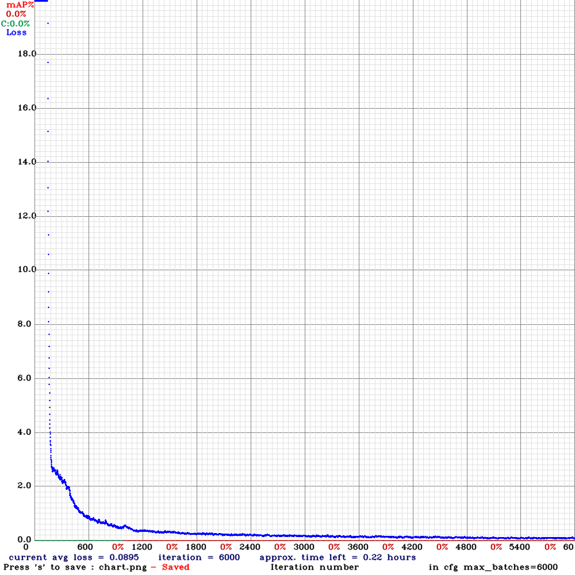
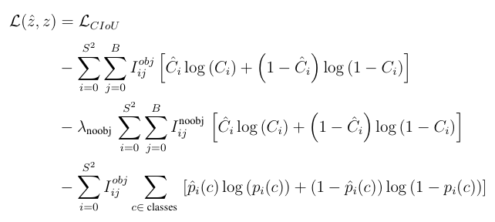
Results
The blue dots show the loss function of each iteration.
The loss function for YOLOv4 can be shown as:
Notes:
To keep it short it uses a Distance-Intersection over Union(IoU) loss. This incorporates the normalized distance between the predicted box and the target box. This loss function helps insure that these predicted boxes are moving in the right direction.

Slide 8
Testing time
YOLO has another function built in called test and demo. I will use both of them to get results to process.
The first is demo to get a visual demo of a test clip.
The second is test to get a file generated with what the computer did.
Both of these commands look similar just using their respected names instead of train.

Slide 9
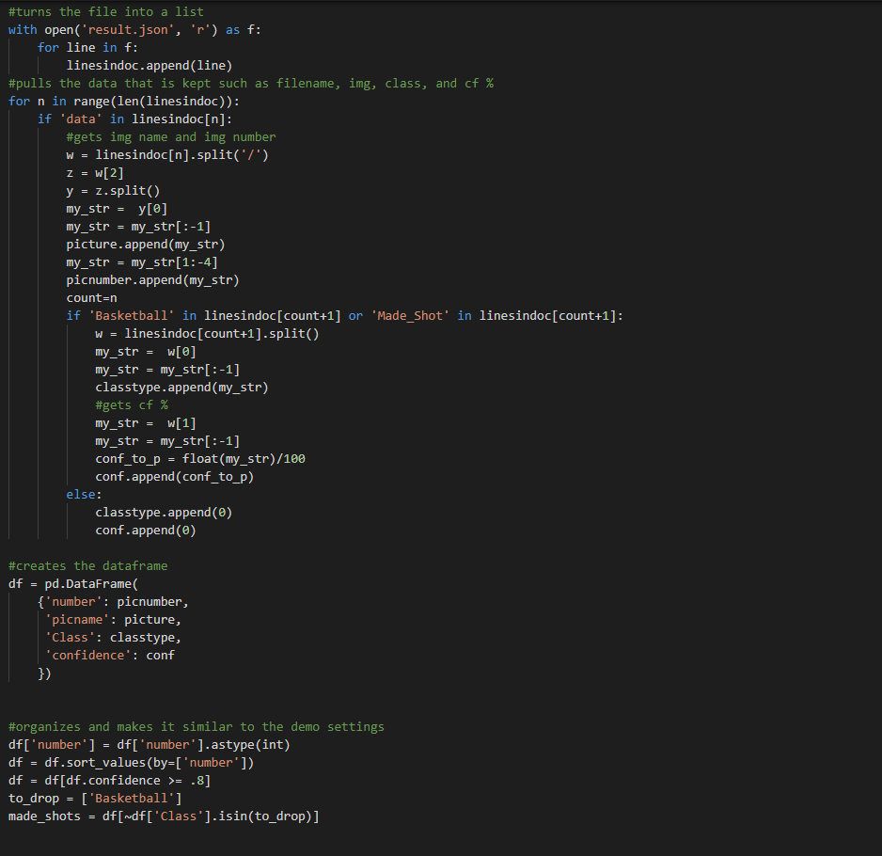
Results
After running the test function I created a script to process the output file and after running that file it showed that there was some false positives.
To the left is a section of the script.

Slide 10
Fin

